Slide 1
FlyNESt Online flight ticket booking platform
(PG-DAC) from
INSTITUTE OF EMERGING TECHNOLOGIES
Project review 1
Presented by :
Dhananjay Ahirrao (250245920023)
Prachiti Sonar (250245920062)
Nirmal gandhwani (250245920056)
Jaykishan Pandey (250245920059)
Lalita KHAIARNAR (250245920047)

Slide 2
1. Introduction The Online Flight Ticket Booking System is a web-based application designed to simplify the process of booking flight tickets. It provides a platform where users can search, compare, and book flight tickets seamlessly using the internet. The system aims to simplify and digitize the flight booking process. It includes user-friendly interfaces and secure payment options.

Slide 3
2. Problem Definition & Scope
Problem Definition
Traditional flight booking systems involve human interaction, physical presence, and long queues. This results in time consumption and lack of real-time availability.
Old flight booking systems need people to stand in lines and take time.
No instant updates about seat availability or flight details.
Hard to book flights anytime or from anywhere.
Mistakes can happen easily, like double bookings.
Not easy to check flight prices or compare options.

Slide 4
Goals & Objectives
Provide a user-friendly platform for booking tickets. Offer real-time updates of flights and availability. Secure user data and payments. Improve customer satisfaction.
Make an easy-to-use online flight booking system.
Show real-time flight details and seat availability.
Keep user data and payments safe.
Let users cancel or change tickets online.
Support payments through UPI, cards, or wallets.
Help users through chatbot or live chat.
Give offers and points for regular users.
Major Constraints & Outcomes
Real-time data sync with airlines. Secure handling of user credentials and payment. High system availability. Responsive user interface.

Slide 5
3. Software Requirements.
*Frontend:* React
*Backend:* JAVA/ ASP .NET
*Database:*MySQL
*API:* External Flight Data API (e.g., Skyscanner, Amadeus)
*Payment Gateway:* Stripe API

Slide 6
4. Performance Requirement.
Hardware Requirements Processor: Intel i5 or higher RAM: 8GB minimum HDD: 500GB or SSD
Software Requirements OS: Windows/Linux Backend: MySQL Frontend: HTML/CSS/JavaScript Server: Apache Tomcat/Node.js

Slide 7
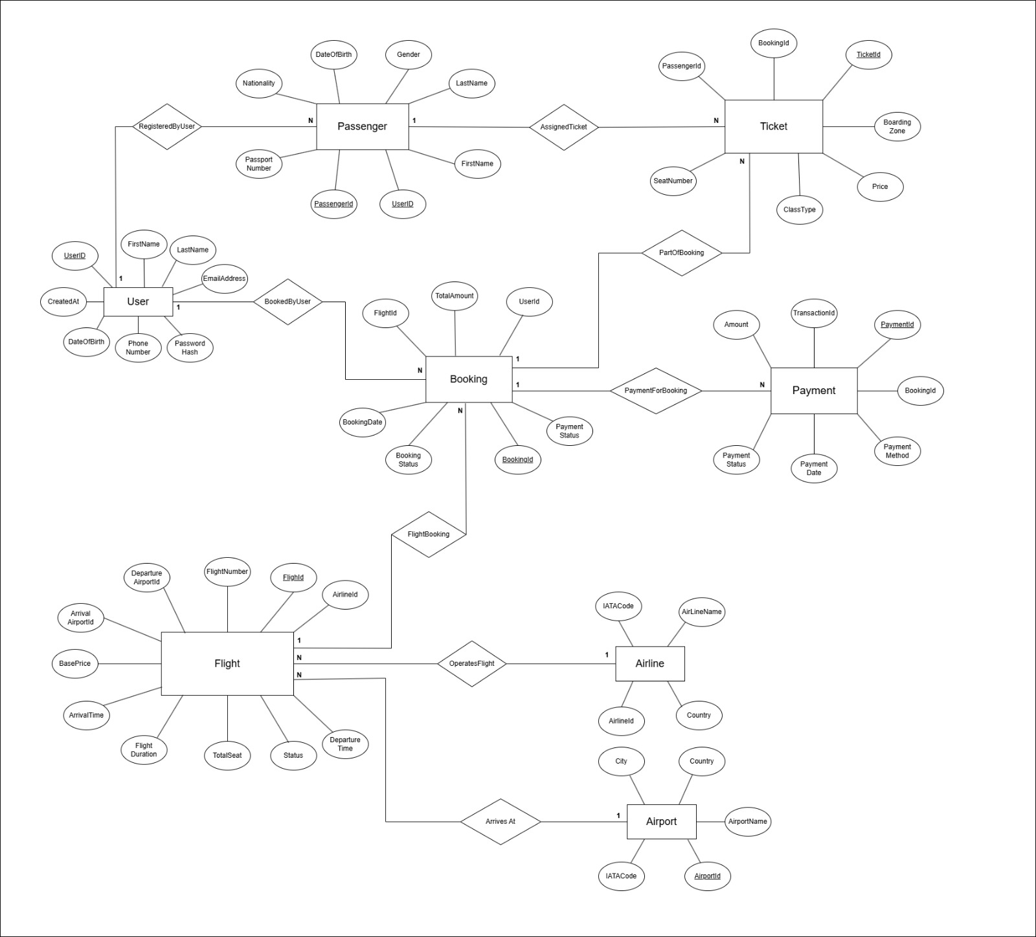
ER DIAGRAM

Slide 8
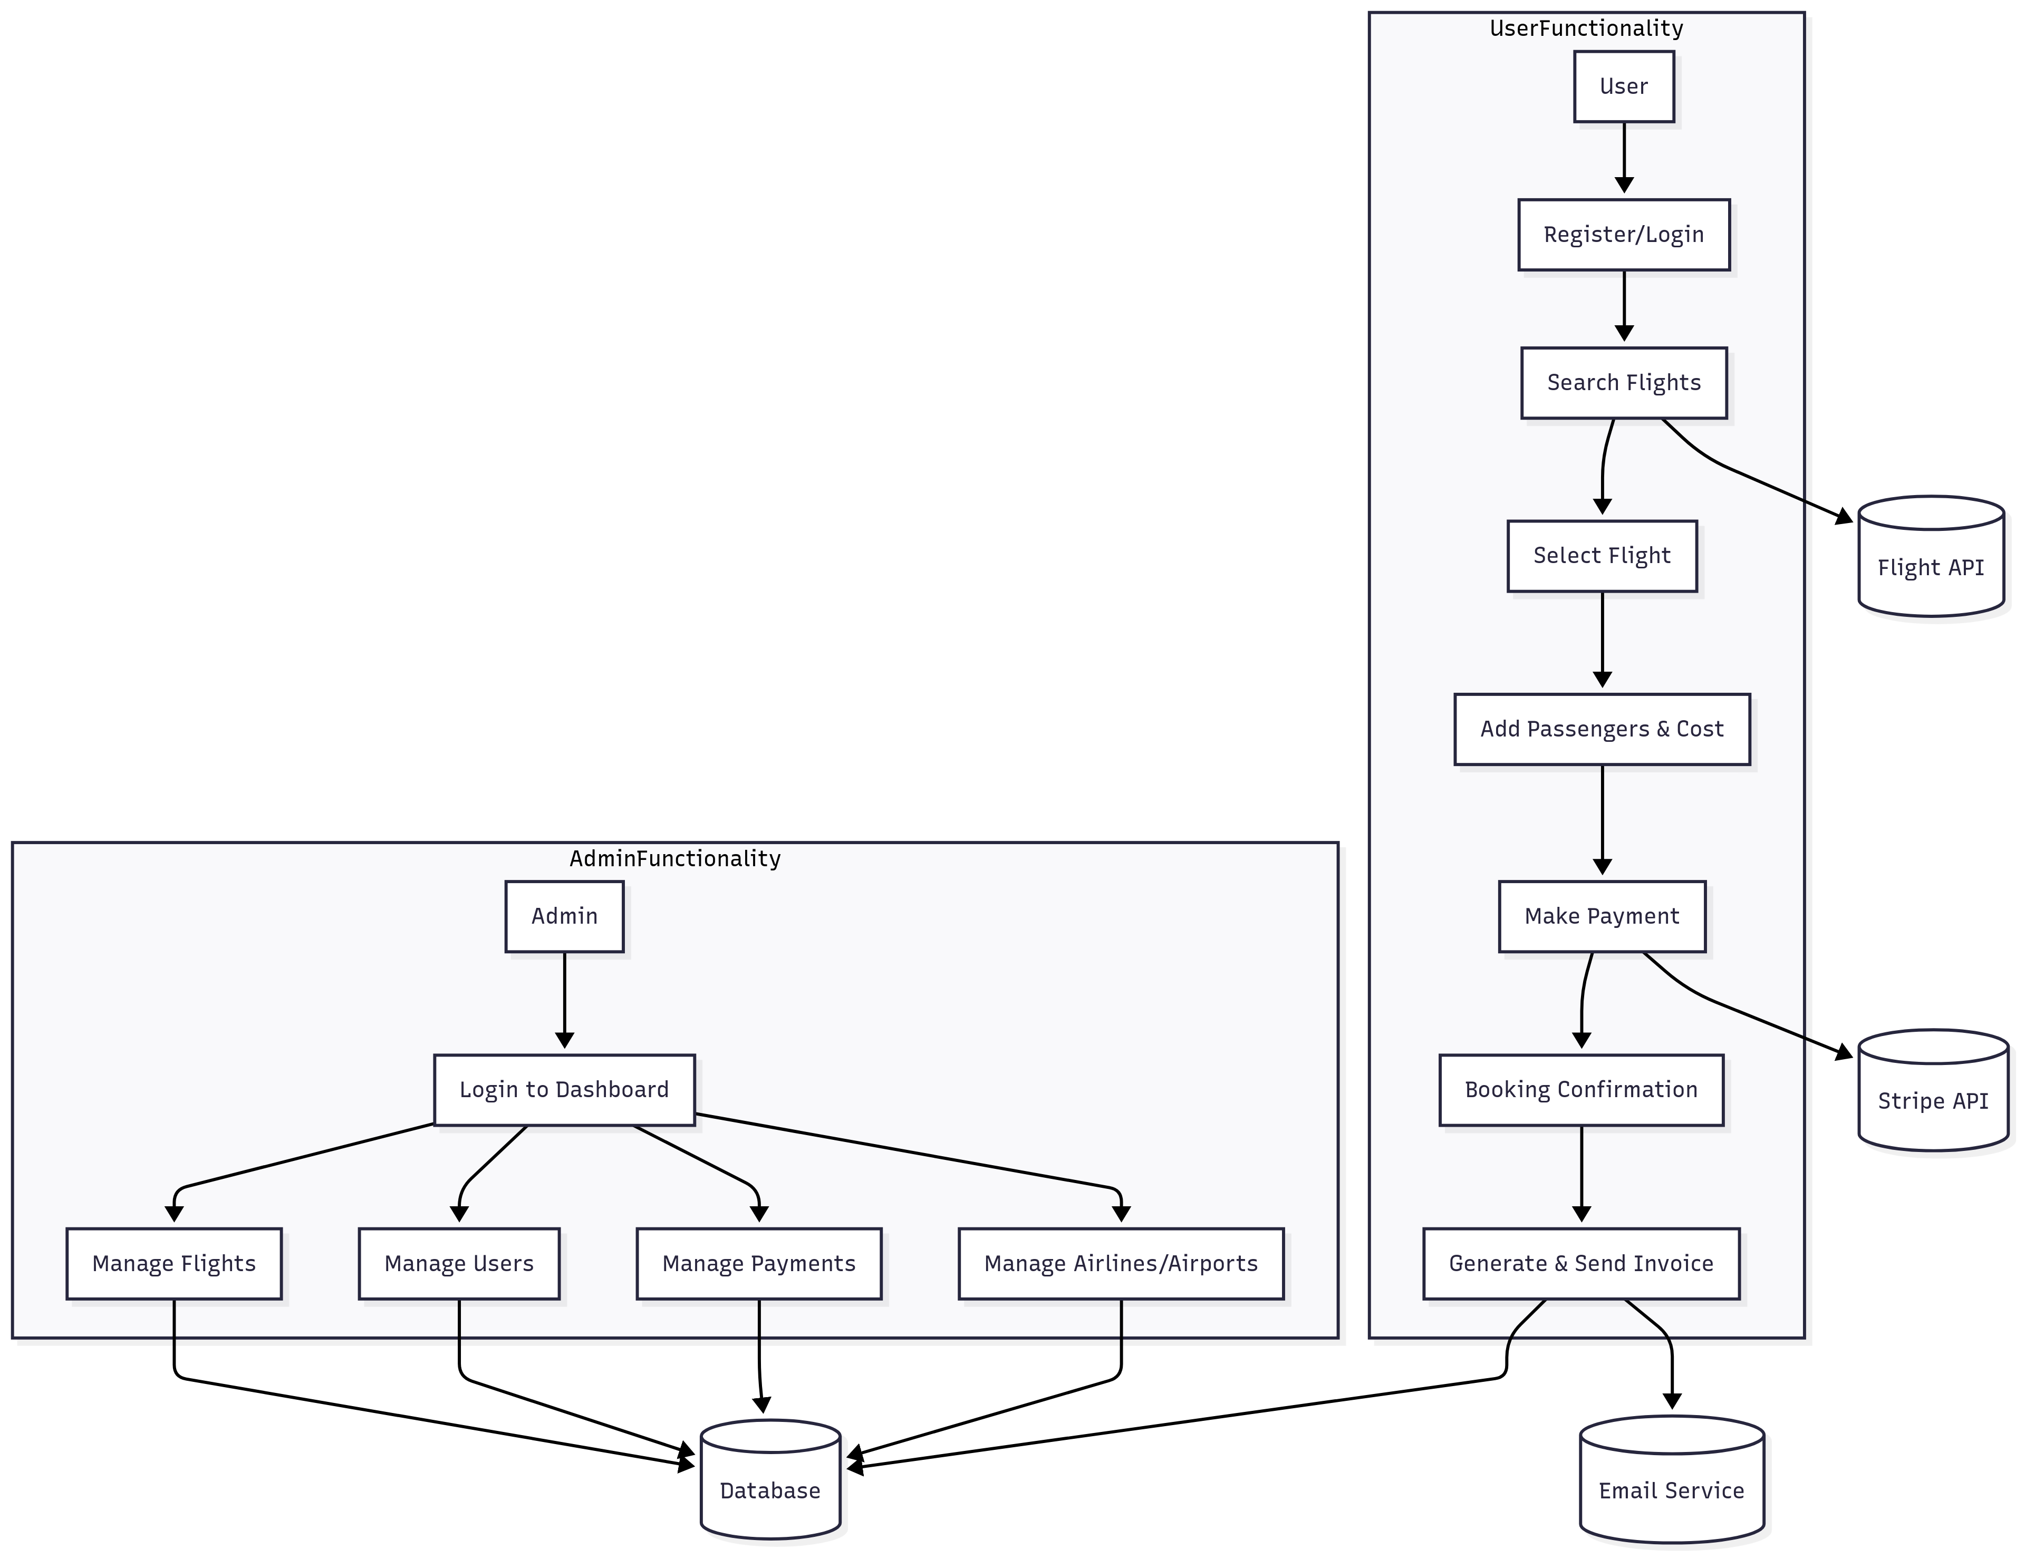
Data flow diagram

Slide 9
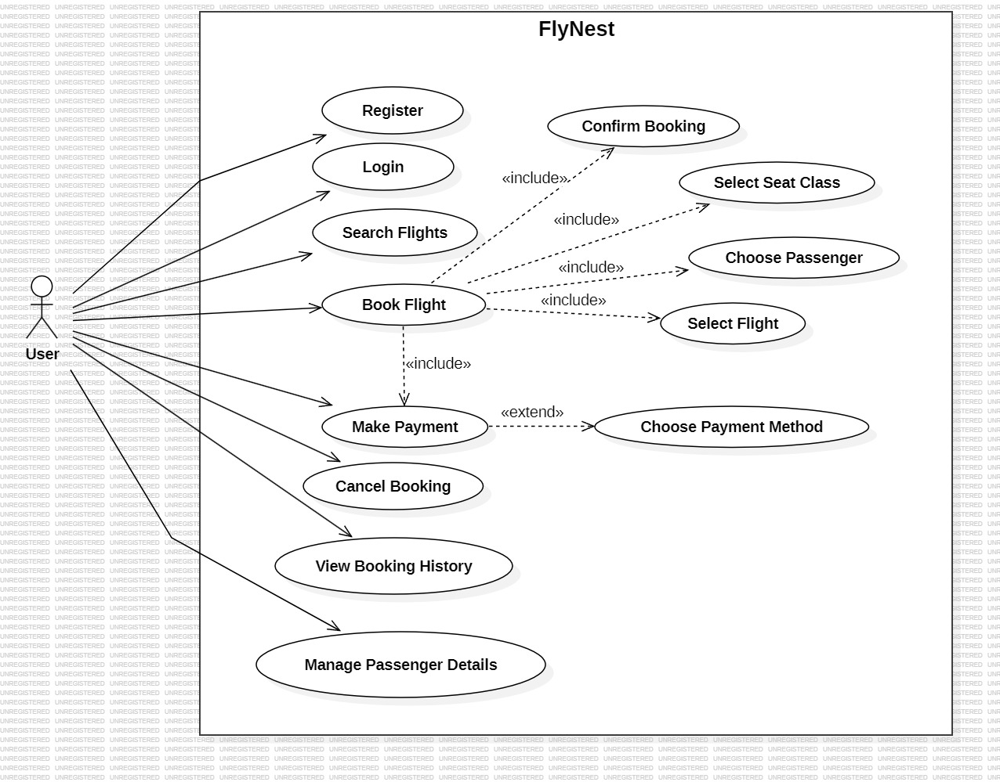
Use case diagram

Slide 10
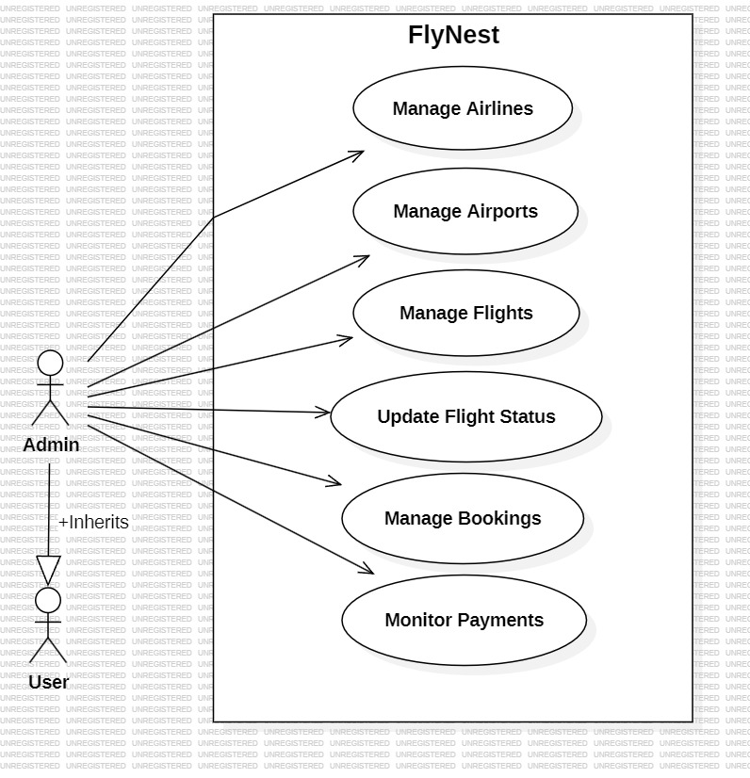

Slide 11
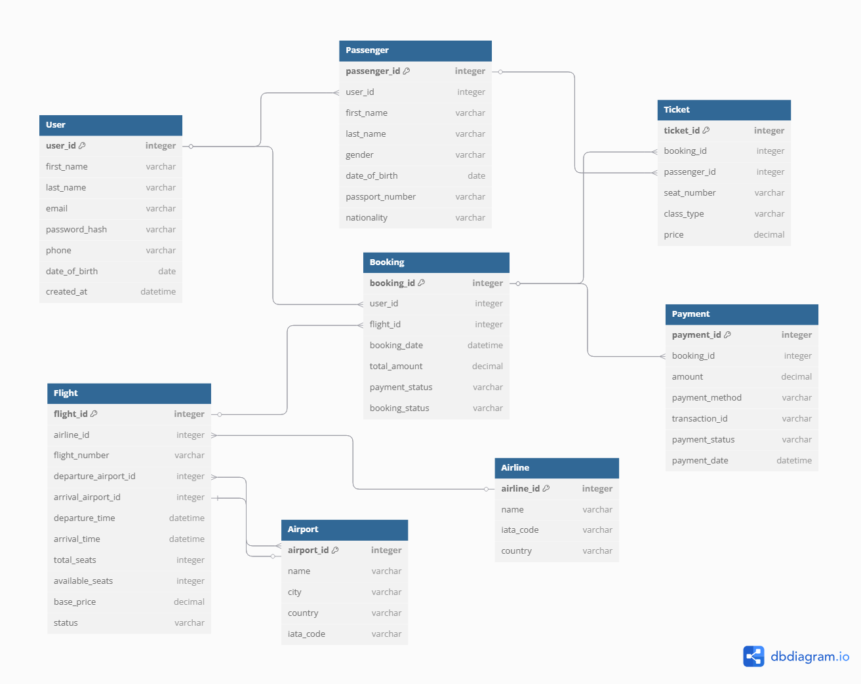
Class diagram

Slide 12
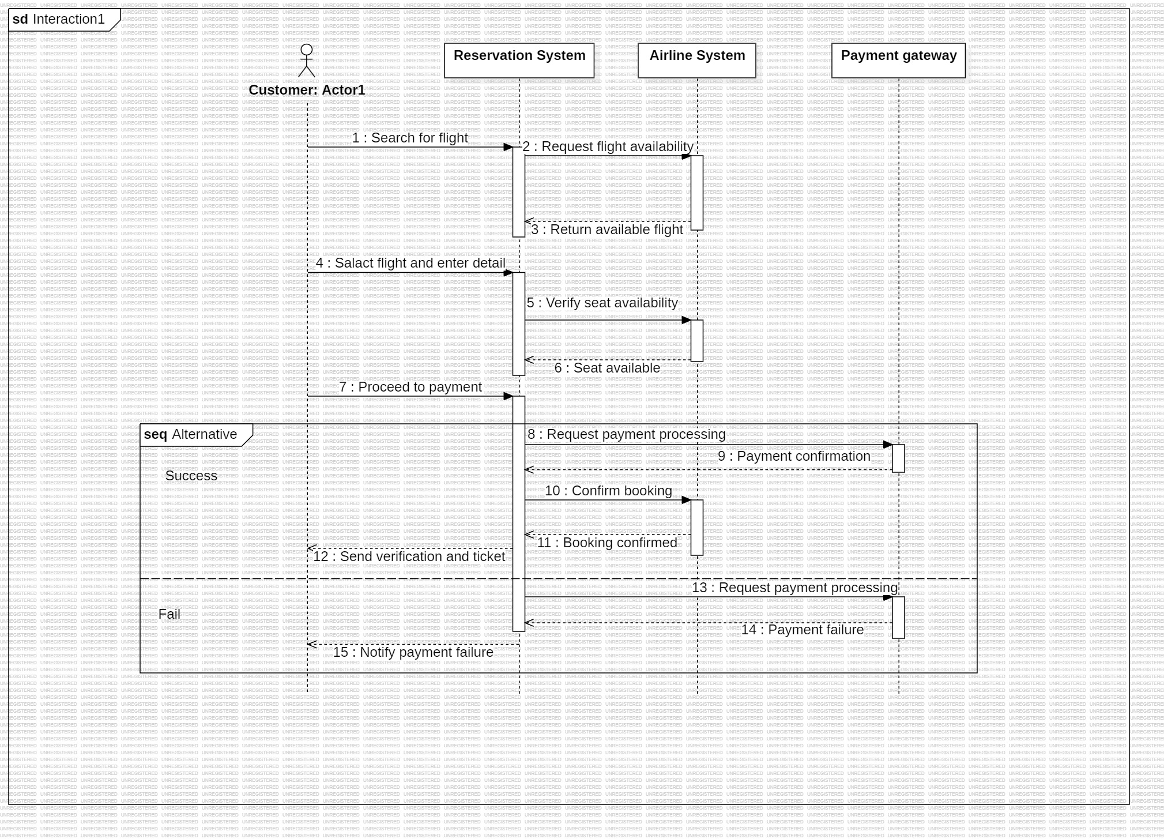
Sequence diagram

Slide 13
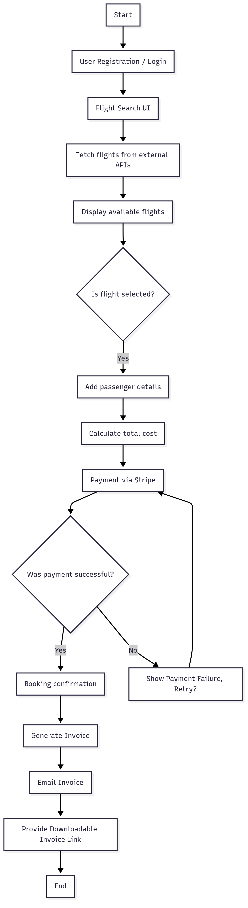
Activity diagram

Slide 14
conclusion
FlyNest enhances the traditional flight booking system by offering a convenient, secure, and fast online platform.
It addresses key pain points and provides a modern travel booking experience.

Slide 15
THANK YOU

